Slide 1
DATABASE MANAGEMENT SYSTEM MINI PROJECT
TOPIC:
QUARANTINE CENTER MANAGEMENT SYSTEM
Group No. :- 39

Slide 2
ABSTRACT:
This project intends to include various features related to a quarantine center i.e. information about no of total rooms, vacant rooms, number of patients, patient details etc. The main aim is to help people who are infected with aur are suspected to be infected with the covid-19 virus know about how to proceed further, like they can get the details about the quarantine center, no of rooms, facility in the rooms, doctors associated with us etc . People who wish to stay in a quarantine center can access these details and decide accordingly. Patients have to show a fresh report which states that the person is found positive and after submitting their personal details, they can book a room for themselves according to their condition i.e. if they are asymptomatic or minor fever then they can book simple rooms and if their condition is not good and have high fever, breathing problems etc then they can book rooms with all facilities.

Slide 3
SCOPE OF THE PROJECT AND OBJECTIVE OF IT:
This project will help people and the government officials in managing the number of covid-19 cases and the serious patients.
To create Quarantine Center Management System that keeps record of patients
their bills and tests
Center details
Doctor’s details and room details

Slide 4
INTRODUCTION ABOUT SQL:
Quarantine center is a place where covid-19 positive patients are kept or rather admitted and are alotted according to their conditions. There they are checked regularly by either permanent or visiting doctors and are governed, kept care by nurses. Along with this, the administration keeps record of the number of patients, patient details, record of rooms and its equipments, doctor details, nurse details, visitor details etc. Doing all this in pen paper mode can be very difficult and can have faults which can serious problems in dealing with such a serious issue.

Slide 5
CNTD..
Here people can do all this digitally which won’t have errors. For booking rooms, patients or their relatives won’t have to come physically and risk their or other people’s lives. Also they can pay the bills online itself to avoid physical contact.If a serious patient slowly recovers and then is shifted to normal room, it will be displayed in the patient profile so the relatives can check their progress. Details of the currently admitted patients and the patients who were admitted in the past are stored for further use. Reviews are also taken by the people which can help to improve the system. Some of the features that it can include in this quarantine center management system are:

Slide 6
Patients and rooms database management: The details of the patients like name, address, room allotted, contact can be stored easily through this application.
Reports: The reports that are given by the doctors can also be stored through this application.
Employee details: The details of the doctors, nurses and guards can be stored easily through this application
Reviews: The reviews by the people who have visited and the patients who are released after recovering are collected in a feedback portal.

Slide 7
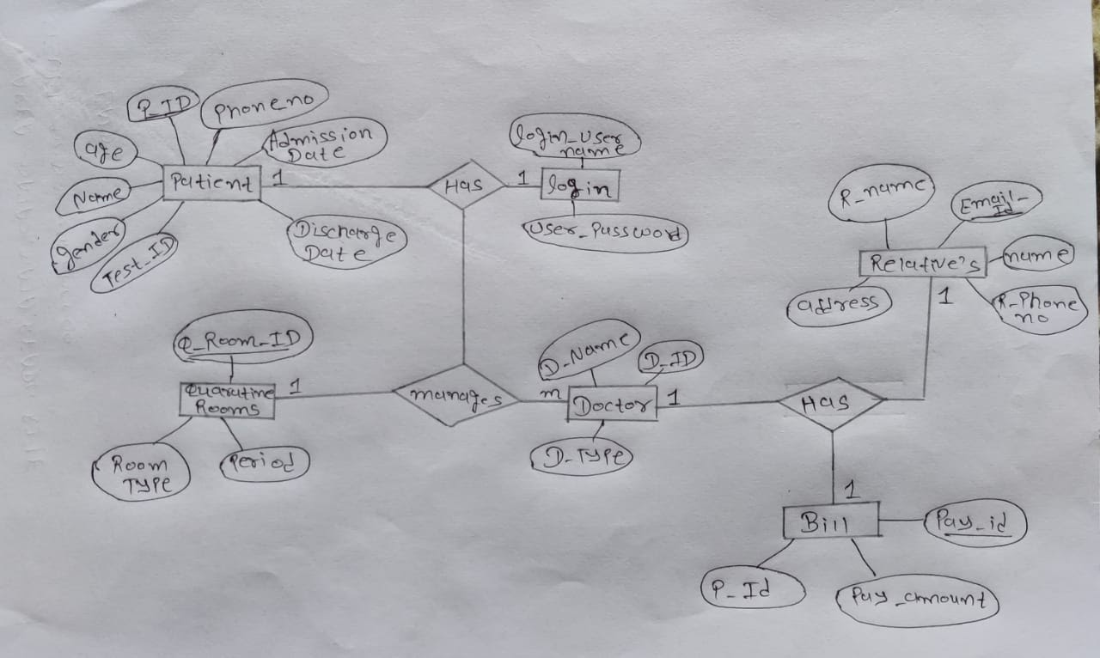
ENTITY RELATIONSHIP DIAGRAM:

Slide 8
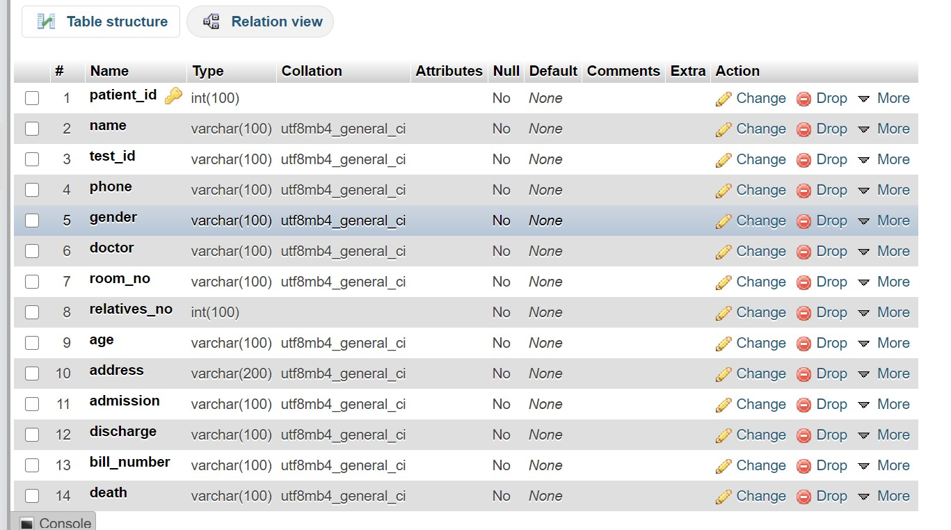

Slide 9
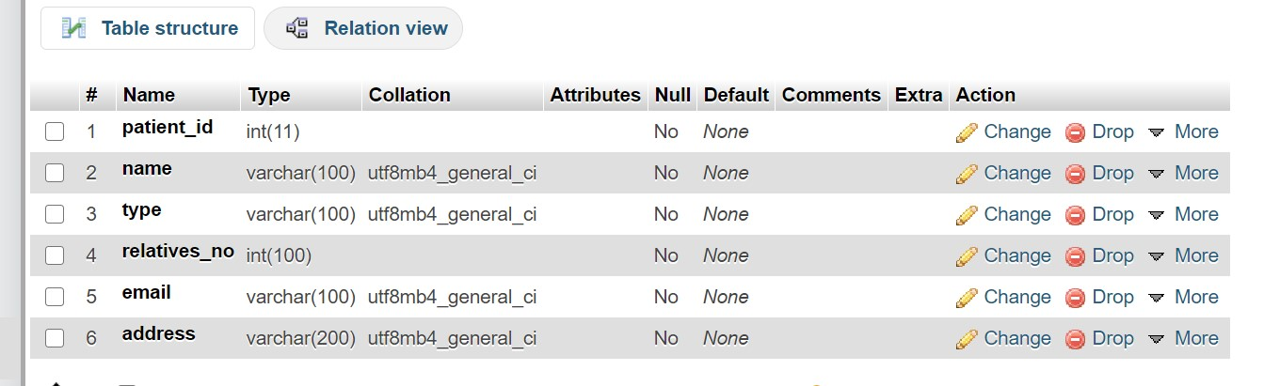
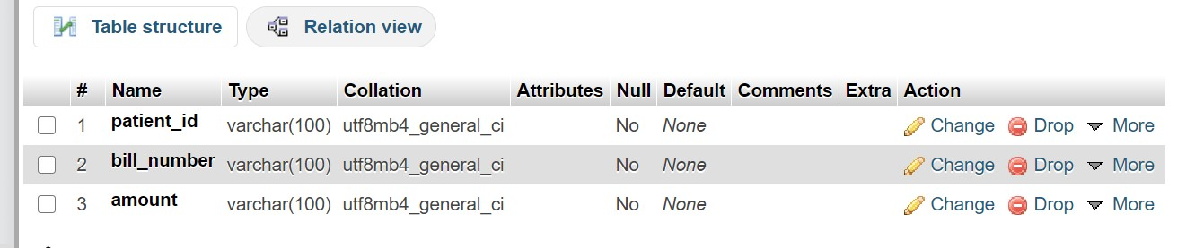

Slide 10
THANK YOU!
SUBMITTED BY:
PATEL ARPIT CHIRAGBHAI
USN-1GA18CS104
5th Semester

